Slide 1
HOUSING PRICING PREDICTION
BY Elisha Ngare

Slide 2
House pricing prediction
House pricing prediction is the process of estimating the market value of a residential property based on a variety of factors such as location, property size, number of bedrooms and bathrooms, and other features. This process is typically done using machine learning algorithms that are trained on historical housing data to identify patterns and make predictions about future prices.

Slide 3
Importing libraries
Pandas – To load the Dataframe
Matplotlib – To visualize the data features i.e. barplot
Seaborn – To see the correlation between features using heatmap
data = pd.read_csv('/content/sample_data/california_housing_train.csv')
print(data)
data.head()

Slide 4
Output:
longitude latitude housing_median_age total_rooms total_bedrooms \
0 -114.31 34.19 15.0 5612.0 1283.0
1 -114.47 34.40 19.0 7650.0 1901.0
2 -114.56 33.69 17.0 720.0 174.0
3 -114.57 33.64 14.0 1501.0 337.0
4 -114.57 33.57 20.0 1454.0 326.0
... ... ... ... ... ...
16995 -124.26 40.58 52.0 2217.0 394.0
16996 -124.27 40.69 36.0 2349.0 528.0
16997 -124.30 41.84 17.0 2677.0 531.0
16998 -124.30 41.80 19.0 2672.0 552.0
16999 -124.35 40.54 52.0 1820.0 300.0

Slide 5
population households median_income median_house_value
0 1015.0 472.0 1.4936 66900.0
1 1129.0 463.0 1.8200 80100.0
2 333.0 117.0 1.6509 85700.0
3 515.0 226.0 3.1917 73400.0
4 624.0 262.0 1.9250 65500.0
... ... ... ... ...
16995 907.0 369.0 2.3571 111400.0
16996 1194.0 465.0 2.5179 79000.0
16997 1244.0 456.0 3.0313 103600.0
16998 1298.0 478.0 1.9797 85800.0
16999 806.0 270.0 3.0147 94600.0

Slide 6
[17000 rows x 9 columns]
longitude latitude housing_median_age total_rooms total_bedrooms population households median_income median_house_value
0 -114.31 34.19 15.0 5612.0 1283.0 1015.0 472.0 1.4936 66900.0
1 -114.47 34.40 19.0 7650.0 1901.0 1129.0 463.0 1.8200 80100.0
2 -114.56 33.69 17.0 720.0 174.0 333.0 117.0 1.6509 85700.0
3 -114.57 33.64 14.0 1501.0 337.0 515.0 226.0 3.1917 73400.0
4 -114.57 33.57 20.0 1454.0 326.0 624.0 262.0 1.9250 65500.0

Slide 7
Data Preprocessing
Now, we categorize the features depending on their datatype (int, float, object) and then calculate the number of them.
obj = (data.dtypes == 'object')
object_cols = list(obj[obj].index)
print("Categorical variables:",len(object_cols))
int_ = (data.dtypes == 'int')
num_cols = list(int_[int_].index)
print("Integer variables:",len(num_cols))
fl = (data.dtypes == 'float')
fl_cols = list(fl[fl].index)
print("Float variables:",len(fl_cols))

Slide 8
Output:
Categorical variables: 0
Integer variables: 0
Float variables: 9

Slide 9
Feature Selection
After the data is cleaned, the next step is to select the most important features that are likely to have the greatest impact on the property's value. This involves using statistical techniques to identify correlations between different features and the final sale price.
plt.figure(figsize=(15,8))
sns.heatmap(data.corr(),
cmap = 'BrBG',
fmt = '2f',
linewidths = 2,
annot = True)

Slide 10
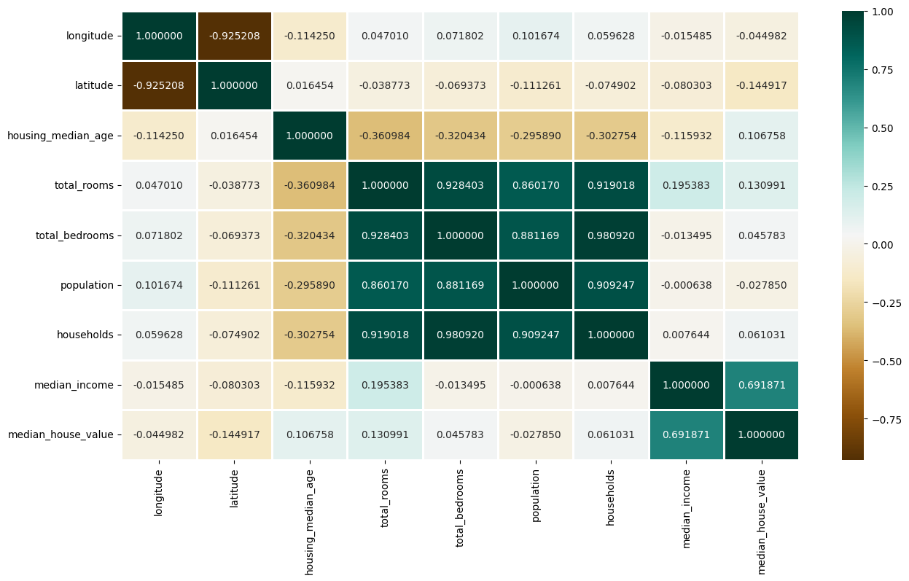
Output:

Slide 11
plt.scatter(data['median_income'],data['median_house_value'])
plt.xlabel('median_income')
plt.ylabel('median_house_value')
plt.title('Relationship between median_income and median_house_value')
plt.show()

Slide 12
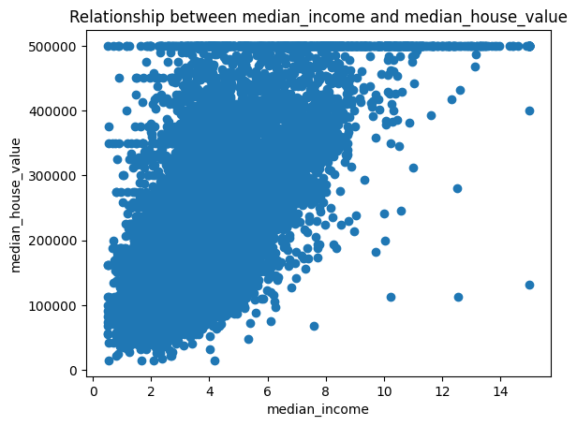

Slide 13
Splitting Dataset into Training and Testing
Once the features have been selected, the next step is to train a machine learning algorithm to predict house prices based on these features. This involves feeding the algorithm historical housing data and using it to identify patterns and make predictions about future prices.
After the algorithm is trained, it needs to be tested and evaluated to ensure that it is accurate and reliable. This involves comparing its predictions against actual sale prices to identify any discrepancies and fine-tuning the algorithm to improve its performance.

Slide 14
from sklearn.model_selection import train_test_split
x=data.drop(['median_house_value'], axis=1)
y=data['median_house_value']
print(x)
print(y)

Slide 15
longitude latitude housing_median_age total_rooms total_bedrooms \
0 -114.31 34.19 15.0 5612.0 1283.0
1 -114.47 34.40 19.0 7650.0 1901.0
2 -114.56 33.69 17.0 720.0 174.0
3 -114.57 33.64 14.0 1501.0 337.0
4 -114.57 33.57 20.0 1454.0 326.0
... ... ... ... ... ...
16995 -124.26 40.58 52.0 2217.0 394.0
16996 -124.27 40.69 36.0 2349.0 528.0
16997 -124.30 41.84 17.0 2677.0 531.0
16998 -124.30 41.80 19.0 2672.0 552.0
16999 -124.35 40.54 52.0 1820.0 300.0

Slide 16
population households median_income
0 1015.0 472.0 1.4936
1 1129.0 463.0 1.8200
2 333.0 117.0 1.6509
3 515.0 226.0 3.1917
4 624.0 262.0 1.9250
... ... ... ...
16995 907.0 369.0 2.3571
16996 1194.0 465.0 2.5179
16997 1244.0 456.0 3.0313
16998 1298.0 478.0 1.9797
16999 806.0 270.0 3.0147

Slide 17
[17000 rows x 8 columns]
0 66900.0
1 80100.0
2 85700.0
3 73400.0
4 65500.0
...
16995 111400.0
16996 79000.0
16997 103600.0
16998 85800.0
16999 94600.0
Name: median_house_value, Length: 17000, dtype: float64

Slide 18
Splitting Dataset into Training and Testing
40% of the data will be reserved for evaluation for testing while the rest which is 60% will be used for training.
The test data will be used once we have done with the training, so when we are confident we can launch the model.
x_train, X_test, y_train, y_test = train_test_split(x,y,test_size=0.4, train_size=0.6, random_state=0)
train_data=x_train.join(y_train)
print(train_data)

Slide 19
Output:
longitude latitude housing_median_age total_rooms total_bedrooms \
0 -114.31 34.19 15.0 5612.0 1283.0
1 -114.47 34.40 19.0 7650.0 1901.0
2 -114.56 33.69 17.0 720.0 174.0
3 -114.57 33.64 14.0 1501.0 337.0
4 -114.57 33.57 20.0 1454.0 326.0
... ... ... ... ... ...
16995 -124.26 40.58 52.0 2217.0 394.0
16996 -124.27 40.69 36.0 2349.0 528.0
16997 -124.30 41.84 17.0 2677.0 531.0
16998 -124.30 41.80 19.0 2672.0 552.0
16999 -124.35 40.54 52.0 1820.0 300.0

Slide 20
population households median_income median_house_value
0 1015.0 472.0 1.4936 66900.0
1 1129.0 463.0 1.8200 80100.0
2 333.0 117.0 1.6509 85700.0
3 515.0 226.0 3.1917 73400.0
4 624.0 262.0 1.9250 65500.0
... ... ... ... ...
16995 907.0 369.0 2.3571 111400.0
16996 1194.0 465.0 2.5179 79000.0
16997 1244.0 456.0 3.0313 103600.0
16998 1298.0 478.0 1.9797 85800.0
16999 806.0 270.0 3.0147 94600.0
[17000 rows x 9 columns]

Slide 21
train_data.hist(figsize=(15,10))
Output:
array([[<Axes: title={'center': 'longitude'}>,
<Axes: title={'center': 'latitude'}>,
<Axes: title={'center': 'housing_median_age'}>],
[<Axes: title={'center': 'total_rooms'}>,
<Axes: title={'center': 'total_bedrooms'}>,
<Axes: title={'center': 'population'}>],
[<Axes: title={'center': 'households'}>,
<Axes: title={'center': 'median_income'}>,
<Axes: title={'center': 'median_house_value'}>]], dtype=object)

Slide 22
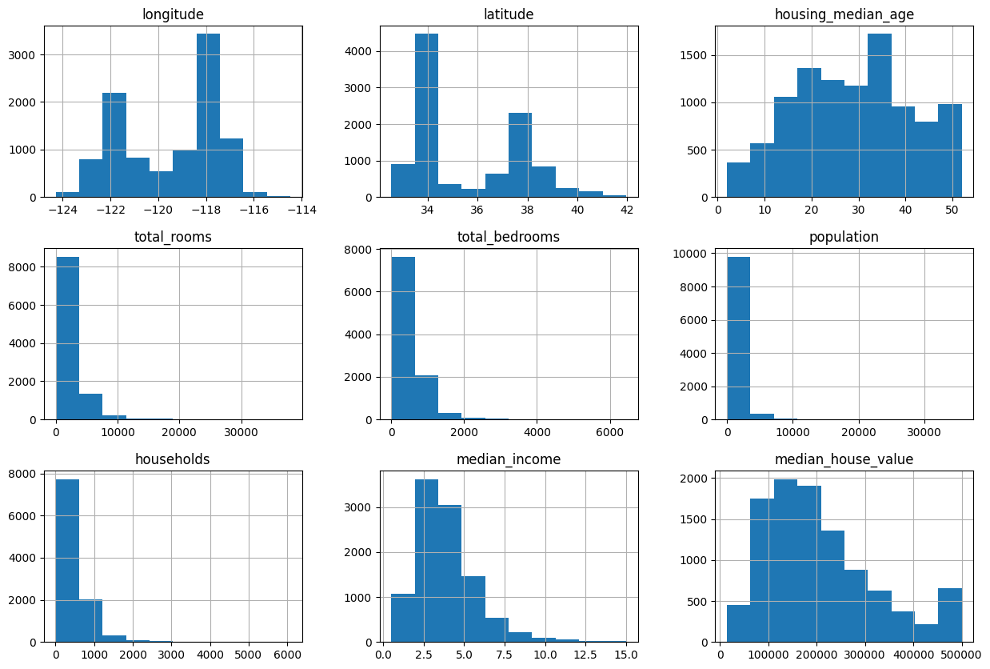

Slide 23
Model and Accuracy
As we have to train the model to determine the continuous values, so we will be using these regression models.
SVM-Support Vector Machine
Random Forest Regressor
Linear Regressor
And To calculate loss we will be using the mean_absolute_percentage_error module. It can easily be imported by using sklearn library

Slide 24
SVM-Support Vector Machine
from sklearn import svm
from sklearn.svm import SVC
from sklearn.metrics import mean_absolute_percentage_error
model_SVR = svm.SVR()
model_SVR.fit(x_train, y_train)
y_pred = model_SVR.predict(x_train)
print(mean_absolute_percentage_error(y_train,y_pred))
Output: 0.5365247594434799

Slide 25
Random Forest Regressor
from sklearn.ensemble import RandomForestRegressor
model_RFR = RandomForestRegressor()
model_RFR.fit(x_train,y_train)
model_RFR.score(x_train,y_train)
Output: 0.9734725700733247

Slide 26
Linear Regressor
from numpy.ma.core import mean
from sklearn.linear_model import LinearRegression
model_LR= LinearRegression()
model_LR.fit(x_train,y_train)
y_pred=model_LR.predict(x_train)
print(mean_absolute_percentage_error(y_train,y_pred))
Output: 0.30460958635485913

Slide 27
Conclusion
Once the algorithm has been trained and tested, it can be deployed and used to make real-time predictions about house prices based on the input data.

